Slide 1
WEDDING AND EVENT PLANNING

Slide 2
SHUBHAARAM
PROJECT GUIDE:-
PROF. SONALI KARTHIK

Slide 3
GROUP MEMBERs
• Dipti Jadhav (203125)
• Sneha Joshi (203127)
•Ashutosh Salunkhe (203162)
•Nisha Yadav (203173)

Slide 4
CONTENT
Wedding and event Planning
Introduction
Abstract
Requirements
Operating system
Services
Website pages
Conclusion
References

Slide 5
Wedding and event Planning
Every wedding you plan will be different.
Every couple will have different needs.
Couples expect wedding planners to fulfil their every need and to make sure nothing is forgotten on their special day.
A wedding is one of the most important days in any couple’s lives.
Wedding planners are often used by couples who work long hours and have little spare time available for sourcing and managing wedding venues and wedding suppliers.

Slide 6
Introduction
Weddings are significant events in people's lives and as such, couples are often willing to spend considerable amount of money to ensure that their weddings are well-organized.
Planners are also popular with couples planning a destination wedding
A wedding is held requires different procedures depending on the nationality of each the bride and the groom.
A Wedding event planner is a professional event coordinator who specializes in planning marriage proposals.

Slide 7
ABSTRACT
The wedding planner is a website which helps to organize successful wedding events for users.
This application provides an easy way to plan their special events.
The user can add all the details of the event and can get the service.
The user can select the type of event, type of food to be served, type of decoration and estimated budget.
All the details given by users will be verified by admin.

Slide 8
Requirements
HTML:- Pages layout has been designed in HTML.
CSS:- CSS has been used for all designing part.
JAVASCRIPT: -All the validation task and animations have been developed by javascript.

Slide 9
Operating system
Windows:- this project can easily be configured on windows operating system.
Linux: -We can run this project also on all versions of linux operating system.
Mac:- We can also easily configured this project on mac operating system.

Slide 10
Services
Interview the couple and parents to identify their needs.
Preparation of the budget
Design and style of the event
Scouting locations
Photoshoots
Planning a detailed checklist
Preparation of the list of participants
Identification of venues for events
Coordination of deliveries / services on the wedding day.

Slide 11
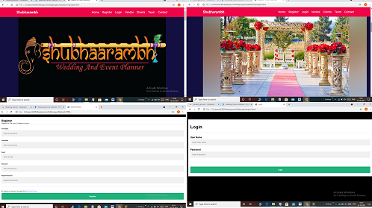
Website pages

Slide 12
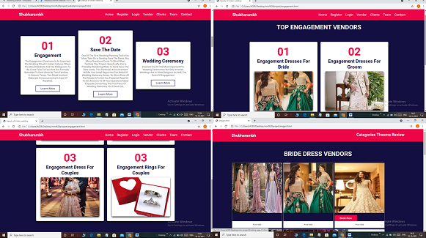

Slide 13
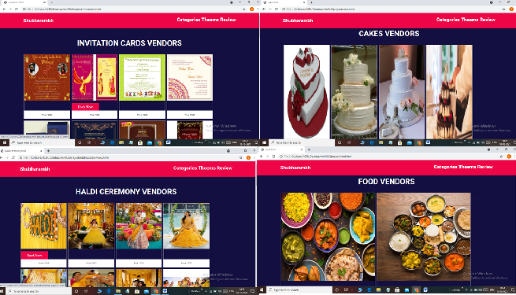

Slide 14
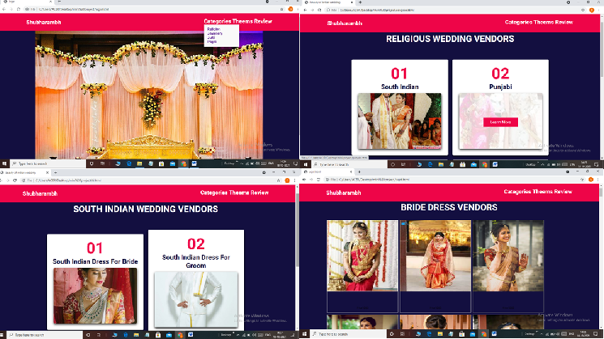

Slide 15
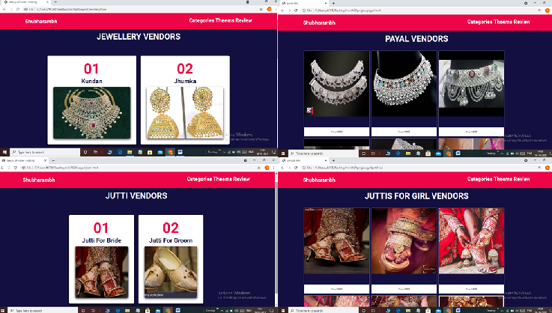

Slide 16
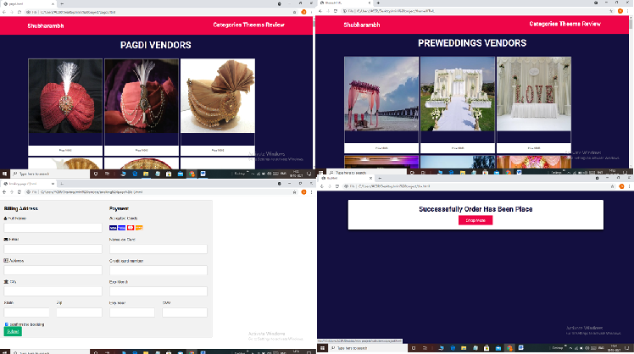

Slide 17
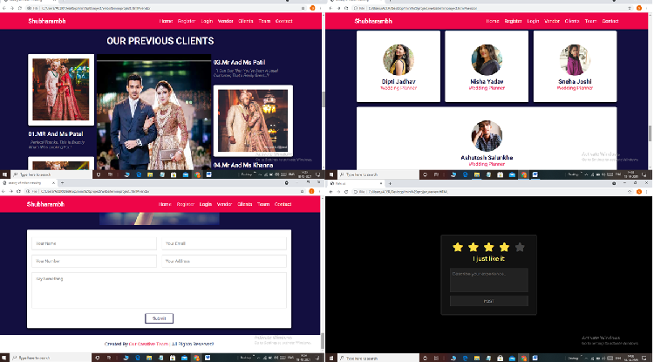

Slide 18
Conclusion
Successful build of project for WEDDING AND EVENT PLANNING.
The wedding planner is a website which helps to organize successful wedding events for users.
This application provides an easy way to plan their special events.
The user can add all the details of the event and can get the service.
The planner will verify and send his response with a confirmation mail.
The user needs to complete the payment process to confirm the order.

